Slide 1



HackTrix’24
Team Name : NAIVEEE CODERS
Members Name : Prathamesh Mukul Patwardhan
Ganesh K
Ashish Sukumar
Palaash Surana
Kamya Ojha

Slide 2



Introduction
The Raspberry Pi, a highly versatile single-board computer, has become a pivotal tool across numerous industries. One particularly critical application is its role in environmental monitoring, specifically in safeguarding against hazardous gases. Timely detection of gas leaks not only saves lives but also prevents environmental catastrophes. Leveraging the Raspberry Pi's capabilities, we aim to develop an affordable and adaptable gas detection system that can be deployed across various settings.

Slide 3
Target Users and market selection
Our target users encompass a wide range of industries and environments where the risk of gas leaks is prevalent. This includes but is not limited to chemical plants, manufacturing facilities, research laboratories, commercial buildings, and residential complexes. Our market selection is strategic, focusing on regions with stringent safety regulations and a high incidence of gas-related accidents. By addressing the needs of these high-risk areas, we aim to make a meaningful impact on safety standards and environmental protection.
In addition to these primary target users, our solution extends to various secondary sectors such as educational institutions, healthcare facilities, and public spaces. Educational institutions, including schools and universities, require robust safety measures in laboratories and workshops where hazardous materials are handled. Similarly, hospitals and healthcare facilities need reliable gas detection systems to ensure patient and staff safety. Public spaces such as shopping malls, entertainment venues, and transportation hubs also benefit from effective gas monitoring to protect visitors and maintain public safety standards. By catering to a diverse range of industries and environments, we aim to enhance safety standards and promote environmental protection on a broader scale.
Industrial facilities
Chemical plants
Manufacturing facilities
Research laboratories
Regions with stringent safety regulations
High-risk environments
Areas prone to gas-related accidents
Industrial hubs
Urban centers

Slide 4

Problems
Current gas detection systems often suffer from issues such as high cost, bulkiness, and the need for specialized maintenance. These factors make them inaccessible to smaller businesses and less adaptable to diverse environments. Additionally, traditional systems may lack scalability, limiting their effectiveness in addressing the needs of growing operations.
Explain
These systems often require significant physical space, posing challenges in environments with limited space availability.
Specialized expertise is typically needed for installation and maintenance, adding to the overall cost and complexity.
Limited scalability of traditional systems makes it difficult for businesses to expand their monitoring capabilities as needed.
The combination of high costs, large footprints, specialized maintenance requirements, and limited scalability creates significant barriers to implementation.

Slide 5
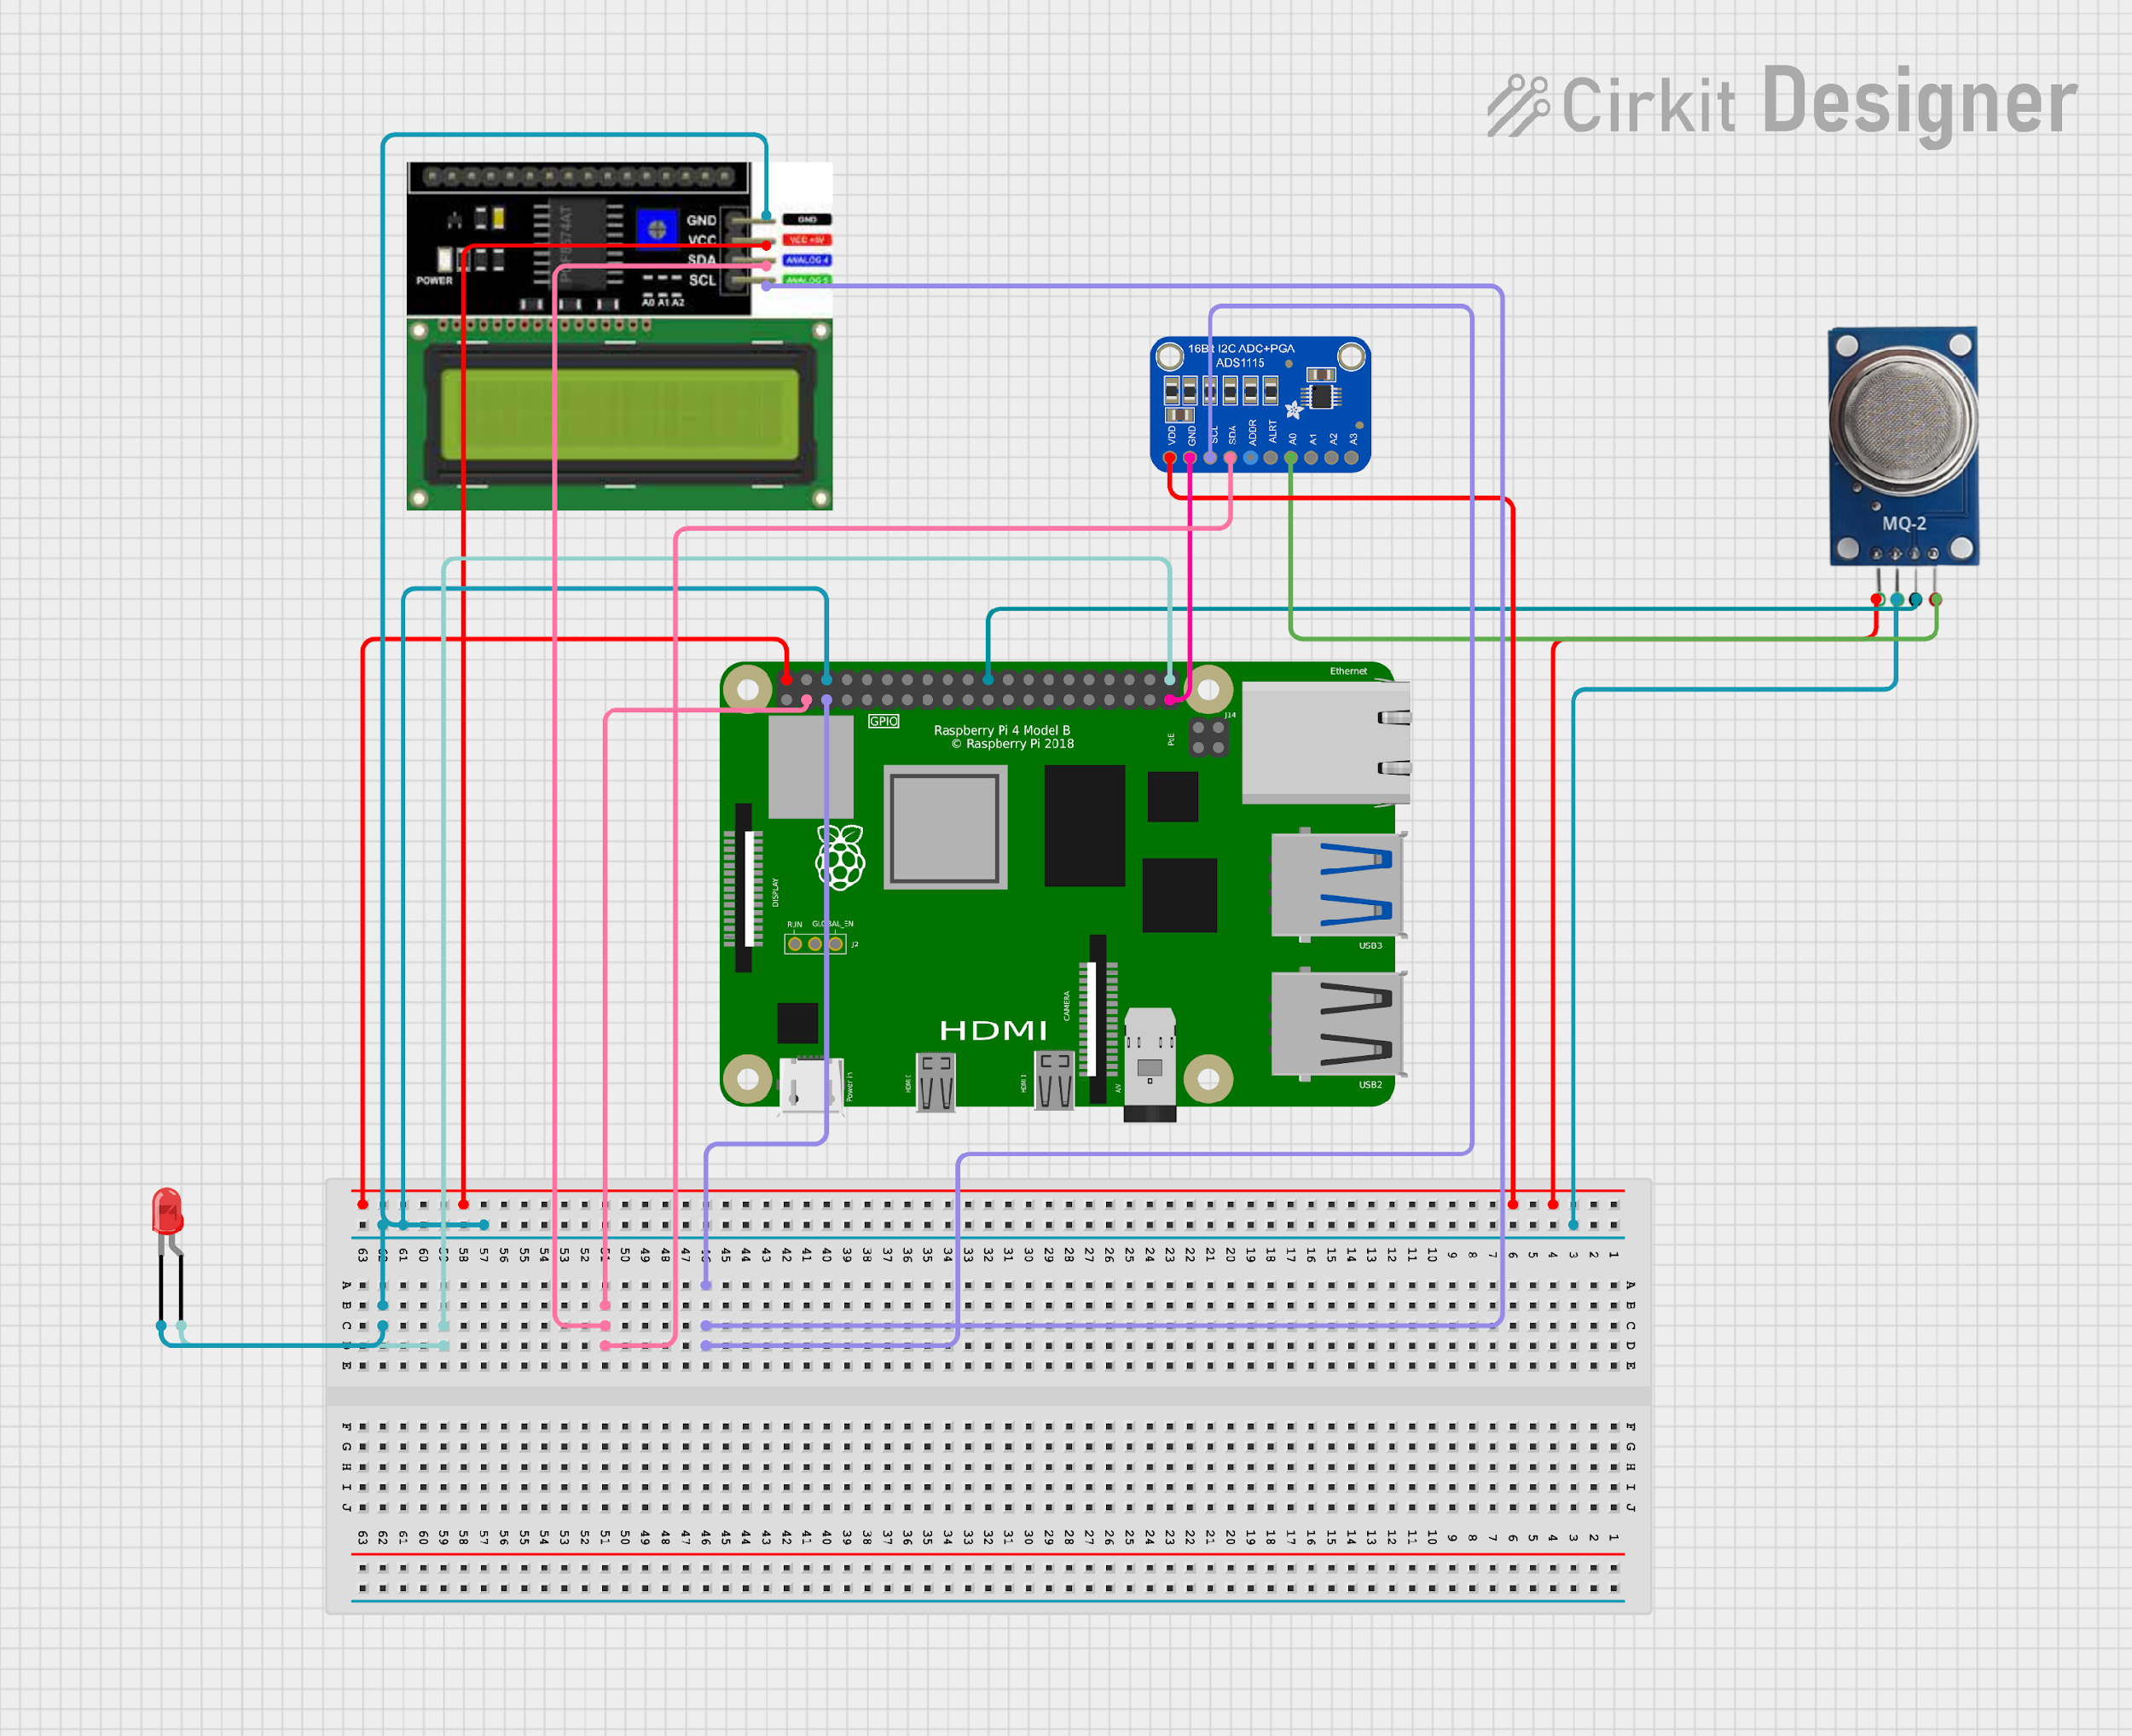

Proposed solution
Solution
Key Takeaways
This project proposes a cost-effective and user-friendly gas detection system with the following key components:
Raspberry Pi 4: Acts as the central processing unit, responsible for controlling the system, processing sensor data, and triggering alerts.
MQ-2 Sensor: Chosen for its high sensitivity to propane and LPG at a relatively affordable price.
GSM Module: Enables the system to send SMS alerts to designated phone numbers upon detecting gas levels exceeding the set threshold.
COST EFFECTIVE: By harnessing the affordability of Raspberry Pi technology, we aim to deliver a gas detection solution that significantly reduces upfront expenses compared to traditional systems.
BULKINESS: Our gas detection system based on Raspberry Pi technology boasts a compact form factor. This design allows for versatile deployment in various environments without consuming excessive space. The reduced footprint ensures flexibility in installation

Slide 6
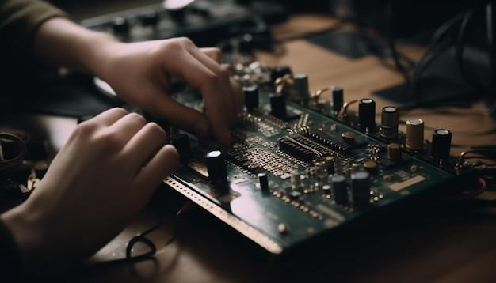
Challenges and Key Learning
Throughout the development process, we encountered various technical challenges that required creative solutions and strategic insights. Sensor calibration emerged as a critical issue, with the need to ensure accuracy and reliability in diverse environmental conditions. Data integrity and security were also paramount, requiring robust encryption protocols and authentication mechanisms. Additionally, power management posed challenges, particularly for remote installations where energy efficiency is crucial. By overcoming these challenges through collaboration, experimentation, and continuous improvement, we gained invaluable insights into the complexities of environmental monitoring and the importance of interdisciplinary collaboration in tackling real-world problems.

Slide 7
Future work
Explore advanced features such as IoT integration and machine learning algorithms.
Develop companion mobile applications for enhanced user engagement.`
Collaborate with industry partners and academic institutions to refine technology and explore new applications.
Explain
Looking ahead, our roadmap includes several avenues for future work and innovation. This includes exploring advanced features such as integration with IoT platforms for seamless data integration and analytics, leveraging machine learning algorithms for predictive maintenance and anomaly detection, and developing companion mobile applications for enhanced user engagement and accessibility. Additionally, we plan to collaborate with industry partners and academic institutions to further refine our technology and explore new applications in environmental monitoring and beyond.

Slide 8
⁠Business Model and Monetization
Raspberry pi4 : 8000 INR
GSM module: 400 INR
I2C LCD display: 1000 INR
ADC1115: 800 INR
MQ2 GAS SENSOR: 100 INR
Explain
To sustain our venture and continue driving innovation, we have devised a comprehensive business model that encompasses multiple revenue streams. This includes offering a freemium model with basic monitoring functionality available for free, while premium features such as advanced analytics and historical data storage are offered through subscription plans. Additionally, we plan to generate revenue through hardware sales of Raspberry Pi-based gas detection kits, supplemented by optional maintenance and support packages. Furthermore, we will explore opportunities for strategic partnerships, licensing agreements, and service contracts to maximize revenue potential and ensure long-term sustainability.

Slide 9
Strategy
To ensure the success of "Raspberry Pi: Safeguarding Against Hazardous Gases," a comprehensive strategy is essential. Initially, thorough market research will identify industries and regions with a high demand for gas detection systems, focusing on areas with stringent safety regulations. The product development phase will prioritize affordability, scalability, and user-friendliness, incorporating features like real-time monitoring and remote access. Collaborations with sensor manufacturers, industry associations, and regulatory bodies will enhance product offerings and ensure compliance with standards. Market segmentation will allow for tailored marketing strategies to address the specific needs of diverse industries, supported by promotional efforts through digital channels and industry events. Customer education and ongoing support will be provided to facilitate successful implementation and utilization of the system. Continuous improvement and innovation will drive product enhancements, while geographical expansion into new markets will be explored strategically. Ultimately, a sustainable business model, including multiple revenue streams and diligent monitoring of key performance indicators, will ensure long-term growth and success.
Conclusion
In conclusion, the integration of Raspberry Pi in gas monitoring systems offers a cost- effective and scalable approach to Safeguarding against hazardous gases. This technology enhances safety but also demonstrates the potential of IoT in addressing critical environmental challenges.

Slide 10
ATTACHED THE VIDEO DEMONSTRATING THE WORKING OF THE PROJECT

